Slide 1





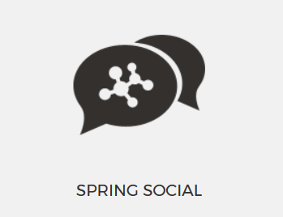

The Right Way Architecture Part 2
Exception Handling, Pagination, Spring Social
Spring Social
SoftUni Team
Technical Trainers
Software University
http://softuni.bg

Slide 2


Table of Contents
Exception Handling
Custom Exceptions
Global Exceptions
Pagination
Spring Social
Facebook

Slide 3
Have a Question?
sli.do #JavaWeb

Slide 4
Exception Handling

Slide 5
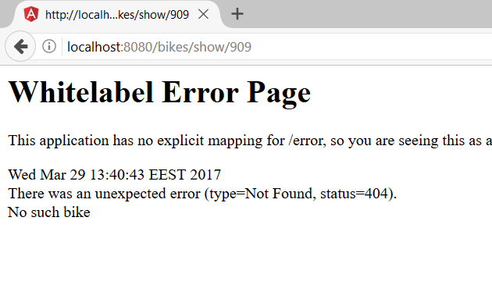
Problem 1
No such bike

Slide 6
Custom Exception
BikeNotFoundException.java
Status Code
Exception Message
@ResponseStatus (value = HttpStatus.NOT_FOUND, reason = "No such bike")
public class BikeNotFoundException extends RuntimeException {
}
Runtime Exception
BikeServiceImpl.java
Bike bike = this.bikeRepository.findOne(id);
if(bike == null){
throw new BikeNotFoundException();
}
Throw Exception

Slide 7
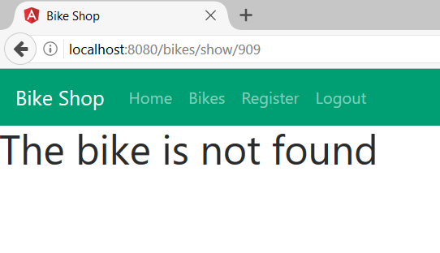
Exception Handling
BikeController.java
Exception Handling
@ExceptionHandler(BikeNotFoundException.class)
public String bikeNotFound(){
return "bike-not-found";
}
Exception Message

Slide 8
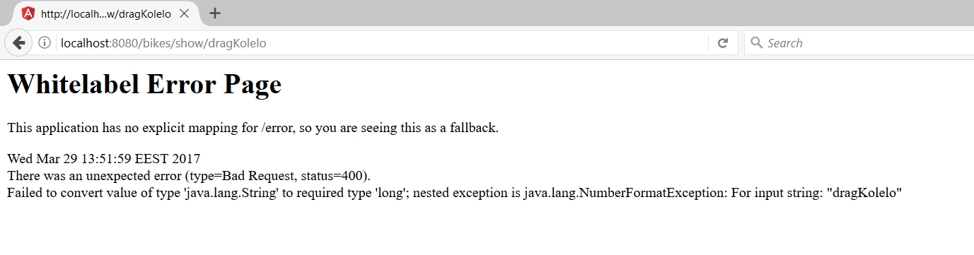
Problem 2
No such bike

Slide 9
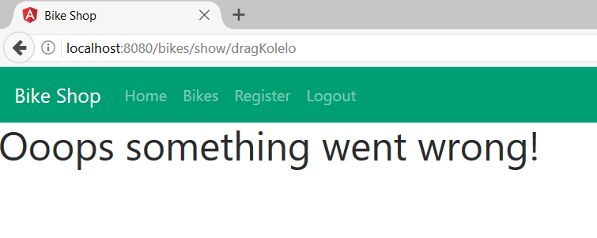
Global Exceptions
GlobalExceptionController.java
Global Exception Handling
@ControllerAdvice
public class GlobalExceptionController {
@ExceptionHandler(Exception.class)
public String getException(){
return "custom-error-page";
}
}
Handles All Exceptions
Returns custom page

Slide 10
Pagination

Slide 11
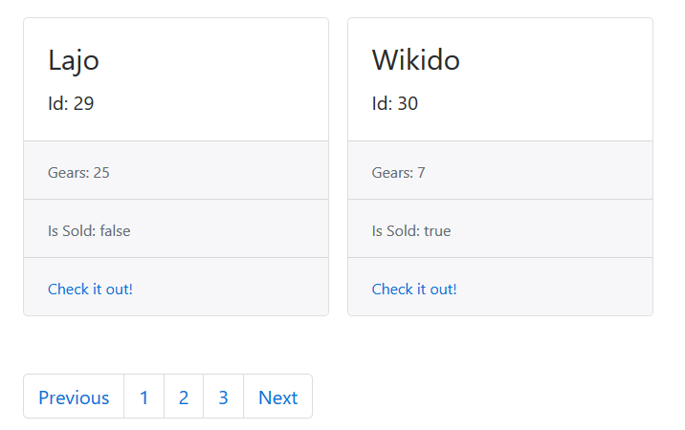
Problem 3
How does it work?

Slide 12
Pagination (1)
BikeRepository.java
@Repository
public interface BikeRepository extends PagingAndSortingRepository<Bike, Long> {
}
Pagination Repository
BikeServiceImpl.java
@Override
public Page<BikeViewModel> listAllByPage(Pageable pageable) {
Page<Bike> bikePage = this.bikeRepository.findAll(pageable);
…
}
Page

Slide 13
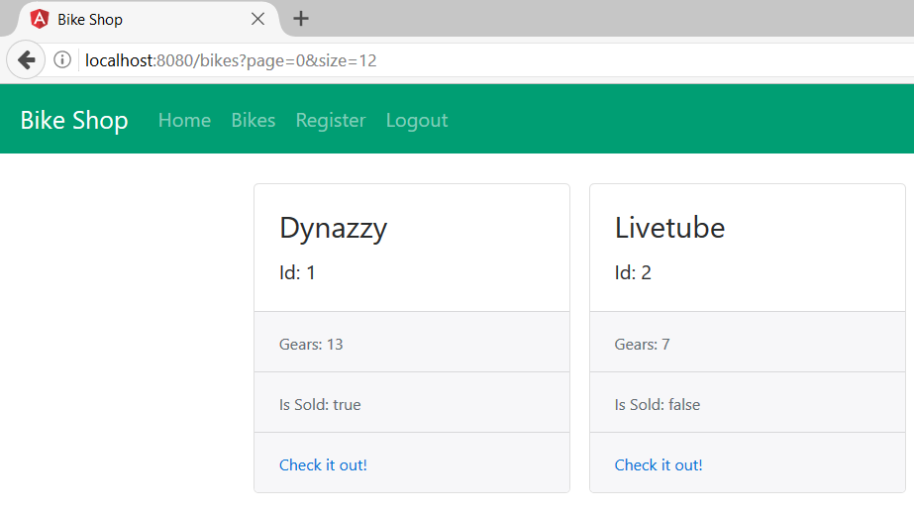
Pagination (2)
BikeRepository.java
@GetMapping("/bikes")
public String getBikes(Model model,
@PageableDefault(size = 10)Pageable pageable){
}
Pageable Instance (has Page and Size)
Page and Size

Slide 14
Facebook Authentication

Slide 15
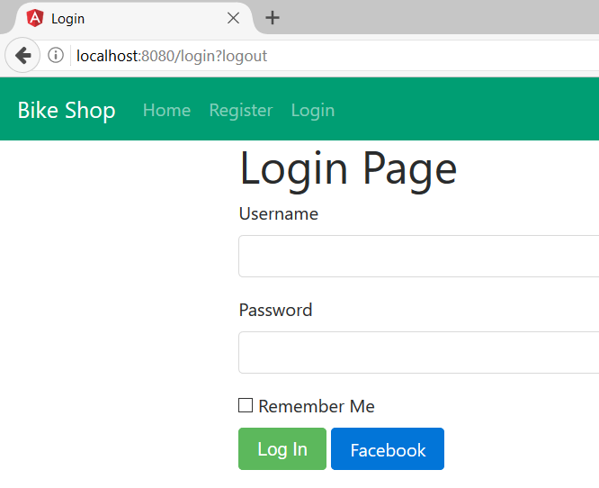
Problem 3
How to authenticate?

Slide 16








Facebook Authentication Control Flow
Spring Security
Web Client
Permissions
Register or Login
POST /signin/Facebook
User profile

Slide 17
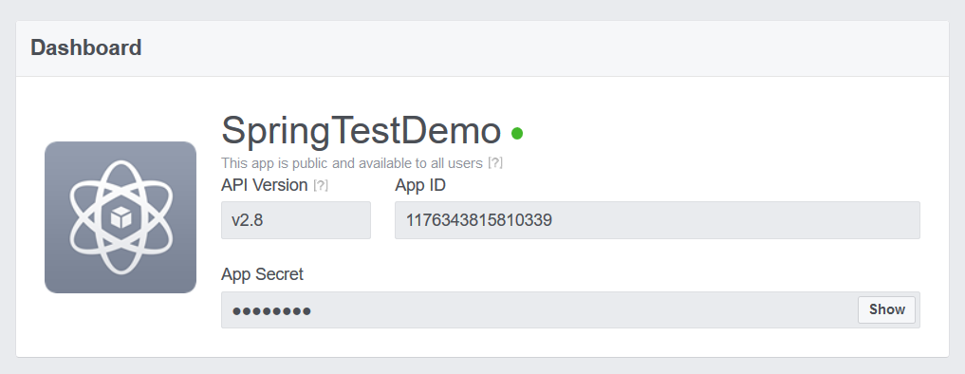
Facebook for Developer Registration
Go to https://developers.facebook.com/
Add a new App

Slide 18
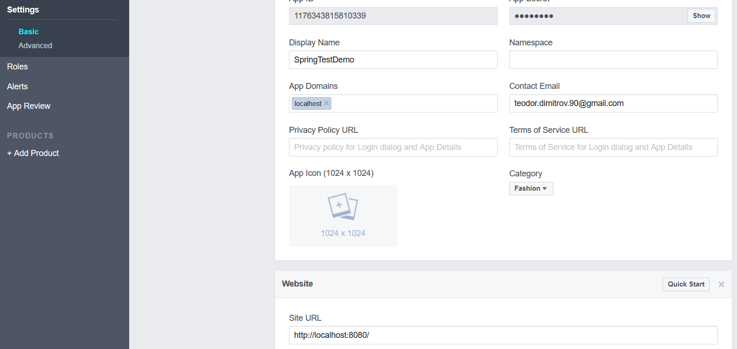
Facebook App Settings
Add your URL
Add your URL

Slide 19
Facebook SignUp
FacebookConnectionSignup.java
@Service
public class FacebookConnectionSignup implements ConnectionSignUp {
@Override
public String execute(Connection<?> connection) {
String userKey = connection.getKey().getProviderUserId();
Facebook facebook = (Facebook) connection.getApi();
String [] fields = { "id", "email", "name"};
User userProfile = facebook.fetchObject(userKey, User.class, fields);
String email = userProfile.getEmail();
if(this.socialUserRepository.findOneByUsername(email) == null){
this.createSocialUser(userProfile);
}
return email;
}
Get Facebook API
Get Data
Return username

Slide 20
Facebook SignIn
FacebookConnectionSignup.java
@Service
public class FacebookSignInAdapter implements SignInAdapter {
@Override
public String signIn(String userId, Connection<?> connection, NativeWebRequest request) {
SocialUser socialUser = this.socialUserRepository.findOneByUsername(email);
if(socialUser != null){
Authentication authentication = new UsernamePasswordAuthenticationToken(socialUser.getUsername(), null, socialUser.getAuthorities());
SecurityContextHolder.getContext().setAuthentication(authentication);
}
return null;
}
Authenticate

Slide 21
Web Security
FacebookConnectionSignup.java
@Autowired
private ConnectionFactoryLocator connectionFactoryLocator;
@Autowired
private UsersConnectionRepository usersConnectionRepository;
@Autowired
private FacebookConnectionSignup facebookConnectionSignup;
@Bean
public ProviderSignInController providerSignInController() {
((InMemoryUsersConnectionRepository) usersConnectionRepository).setConnectionSignUp(facebookConnectionSignup);
return new ProviderSignInController(connectionFactoryLocator, usersConnectionRepository, facebookSignInAdapter);
}
SignIn Controller

Slide 22
Application Properties
FacebookConnectionSignup.java
spring.social.facebook.appId=1176343815810339
spring.social.facebook.appSecret=4676deb64914341a9bd4c01ef85245e4
Key and Secret
Facebook Button
FacebookConnectionSignup.java
<form action="/signin/facebook" method="POST">
<input type="hidden" name="scope" value="public_profile, email" />
<div id="fb-action" class="form-group">
<input class="btn btn-primary" type="submit" value="Facebook"/>
</div>
</form>
Permissions

Slide 23


Summary
Exception Handling – Spring provides an easy way to handle exceptions via @ExceptionHandling and @ControllerAdvice
Pagination – functionality to split data on different pages
Spring Social – easy way to authenticate with Facebook

Slide 24








Web Development Basics – Course Overview
https://softuni.bg/courses/

Slide 25
License
This course (slides, examples, demos, videos, homework, etc.) is licensed under the "Creative Commons Attribution-NonCommercial-ShareAlike 4.0 International" license

Slide 26






Free Trainings @ Software University
Software University Foundation – softuni.org
Software University – High-Quality Education, Profession and Job for Software Developers
softuni.bg
Software University @ Facebook
facebook.com/SoftwareUniversity
Software University @ YouTube
youtube.com/SoftwareUniversity
Software University Forums – forum.softuni.bg

